Slide 1
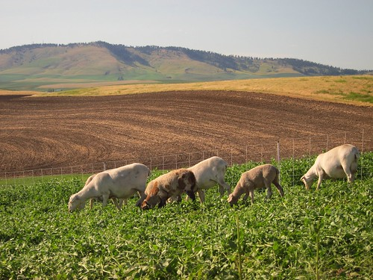
Theories and Practices of Sustainable Development (TPSD)
Farm system Characterisation & Impact Analysis of Center Region Agriculture Parishes
Presentation Date: 3rd June 2022

Slide 2
Section 1
Framework & Objectives of the study

Slide 3
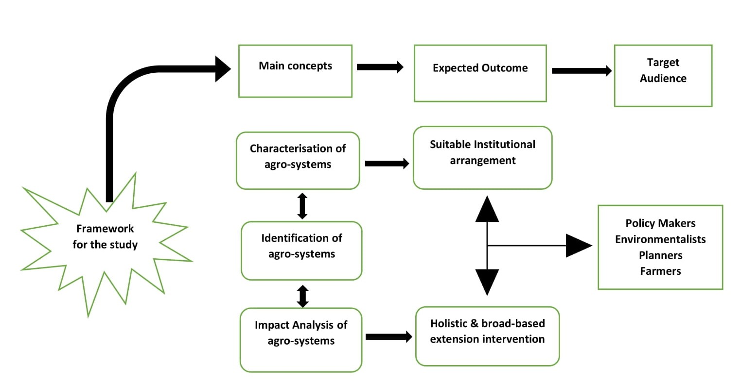
Framework for farm characterisation & impact analysis

Slide 4
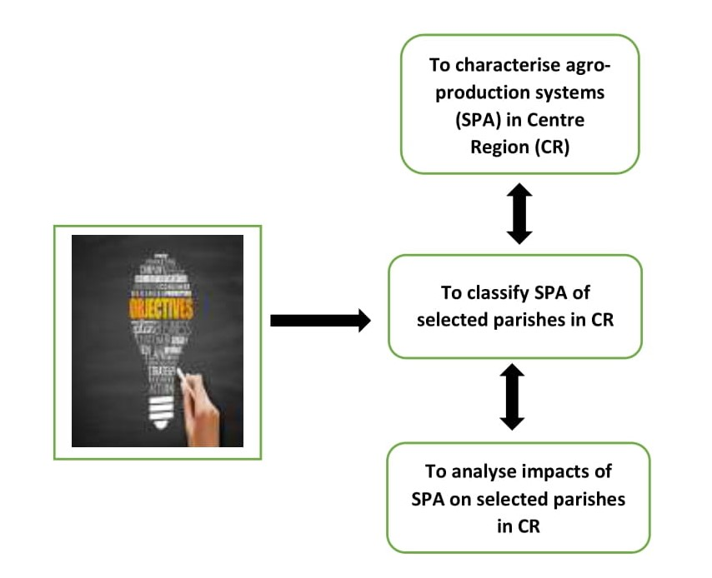
Objectives of the study

Slide 5
Section 2
Data and Methodology

Slide 6
Data Source
>>> National Institute of Statistics
>>>Agricultural Census 2009
>>>Data for “Center Region” extracted from aggregate database

Slide 8
Section 3
Results for Centre Region

Slide 9
SPA Characterisation for Centre Region
Data Highlights
Predominance of Arable surface within the region
Regional topography displays the diverse types of livestock and crops both as well as in choice and in income
Region is composed mostly of temporary crops
Region’s livestock is predominantly composed of Granivore, followed by Goat livestock
Approximately 1/5 of the region’s land surface is occupied by SPA (20% of total landscape)
SPA´s are predominantly of small dimensions
Main crops are related to animal feed (crop livestock)

Slide 10
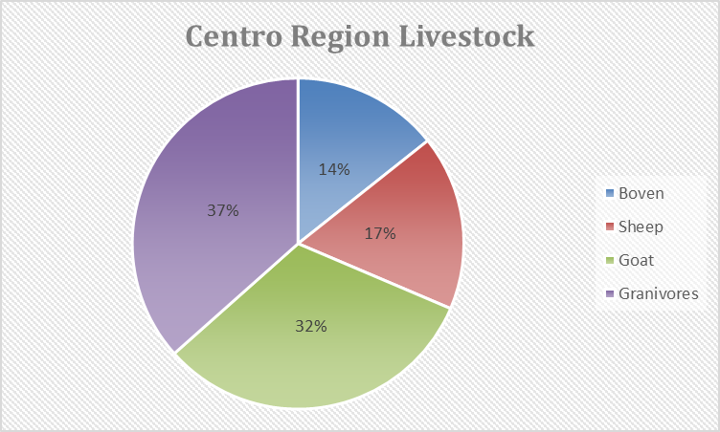

Slide 11
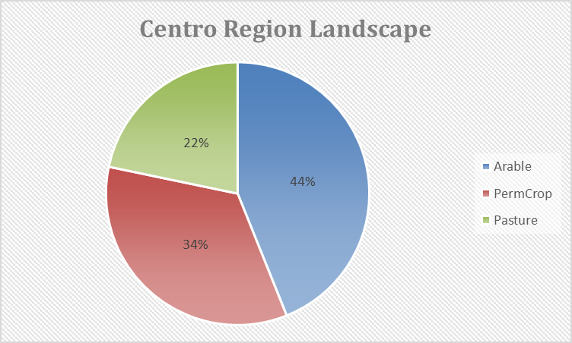

Slide 12
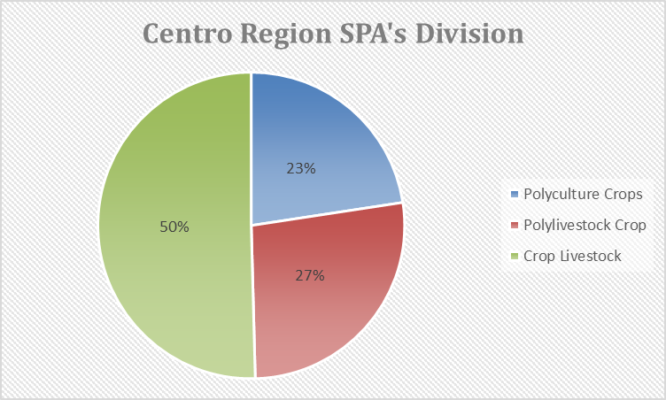

Slide 13
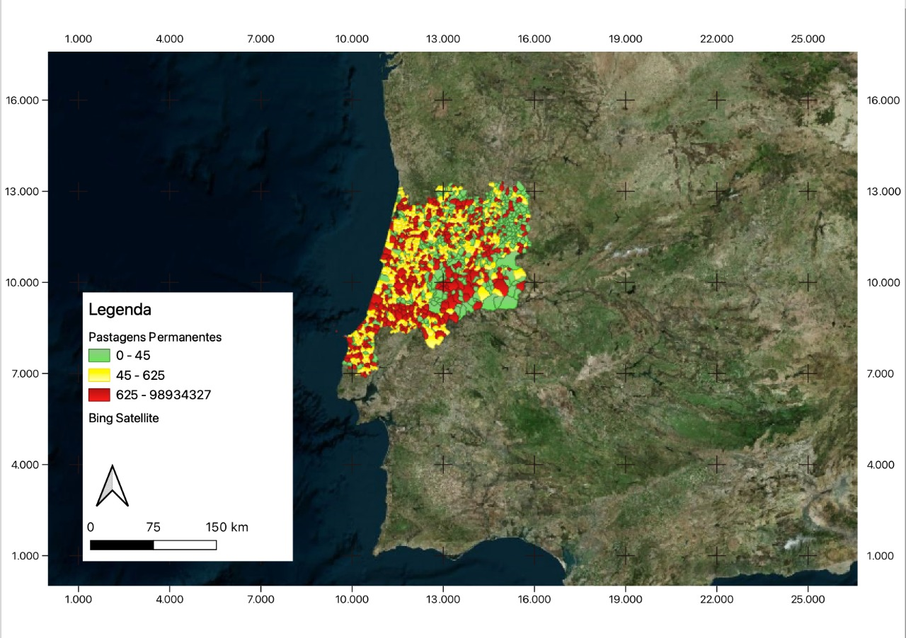
QGIS Topology Mapping for Centre Region

Slide 14
ANOVA Test for Centre Region
The significance column is the P-value, which is the probability of rejecting the null hypothesis if it is right (implying a wrong rejection).
We want this probability to be as small as possible and always less than 5% (0.05).
From our analysis, all the variables passed the Anova criteria because the P-Values are less than 0.05. However, not all of them passed the ETA square criteria
Since our P-value is less than 0.05, we reject the null hypothesis that all averages are equal across clusters because they are not equal

Slide 15
Measure of Association for Centre Region
The ETA square can be interpreted as the proportion of variance in a given variable
It represents the variance between clusters and not the variance within clusters.
It should be as high as possible.
If it is very low, most of the variance is within clusters and not good to describe the clusters.
The values in red (on the Excel/SPSS) are the ones separated from the clusters

Slide 16
Implications of impact analysis for Centre Region
Parishes for Central Region were split into 5-, 6-, 7-, and 8-clusters
The 8-clusters was selected for further impact analysis
The order of decreasing intensity is from Very High Intensive (Ward 1); High Intensive (Ward 3); Intensive (Ward 2 & 8 ); and Low Intensive (Ward 4,5,6,7)

Slide 17
References
Recenseamento agricola 2009 (2011). Censo agrícola. Lisboa: Instituto Nacional de Estatística.
Instituto Nacional de Estatística (2016), inquérito à Estrutura das Explorações Agrícolas
Jones, N., Graaff, J., Duarte, F., Rodrigo, I., & Poortinga, A. (2014). Farming systems in two less favoured areas in Portugal: Their development from 1989 to 2009 and the implications for sustainable land management. Land Degradation & Development. 25. 10.1002/ldr.2257.
Silva, J.F., Santos, J.L., Ribeiro, P.F., Canadas, M.J., Novais, A., Lombac, A., Magalhãesa, M.R., Moreirac, F. (2020). Identifying and explaining the farming system composition of agricultural landscapes: The role of socioeconomic drivers under strong biophysical gradients. Landscape and Urban Planning, 202, 103879.

